Slide 1

Will Singapore reach an Overall Recycling Rate of 70% by 2030?

Slide 2
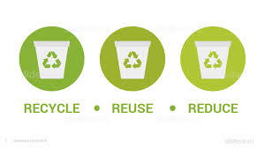
INTRODUCTION
The overall waste recycling rate in Singapore is 57% as of 2022.
The National Environment Agency (NEA) has implemented the Net Zero Waste Masterplan, which is a comprehensive strategy that aims to reduce waste and increase recycling rates.
The plan sets out various targets and initiatives to achieve a sustainable and zero-waste future.
One of the key targets outlined in the Zero Waste Masterplan is to achieve a recycling rate of 70% in Singapore by the year 2030.

Slide 3
Data used for Analysis
Population in Singapore since 2003
Incoming tourist arrivals since 2003
Waste management data since 2003
National Environmental Agency Development Expenditure since 2008
Exported recycled goods from 2015 to 2019
Sources :
National Environmental Agency website
singstat.gov.in
Ministry of Sustainability and Development website

Slide 4
Analysis Performed
As-is Analysis
Will Singapore reach an overall recycling rate of 70%?
Solver Analysis
How can Singapore reach an overall recycling rate of 70%?
Trade-off Analysis
What if the NEA increases Development Expenditure?
Sensitivity Analysis
What if new export markets for recycled goods are found?
What if a new technological advancement comes up for recycling plastics?

Slide 5
Basis of our Analysis
Consideration of human factors like population and incoming tourist to calculate waste generated in different categories.
We have assumed a three-year period for the NEA Development expenditure to have an impact on food recycling rate.
We have assumed total recyclable exported to impact recycling rate of paper linearly based on data and the business context.
We have assumed the amount spent on waste recycling annually as a constant proportion of NEA Development Expenditure.

Slide 6

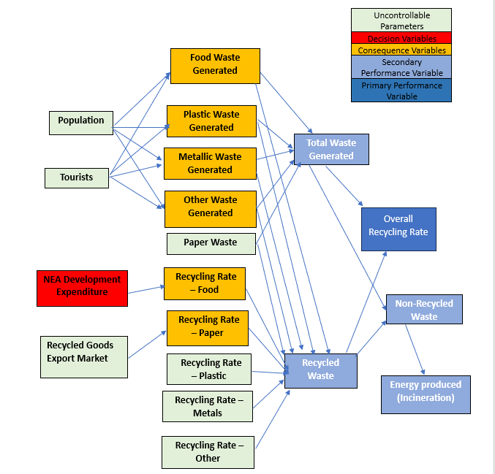
Influence Diagram

Slide 7
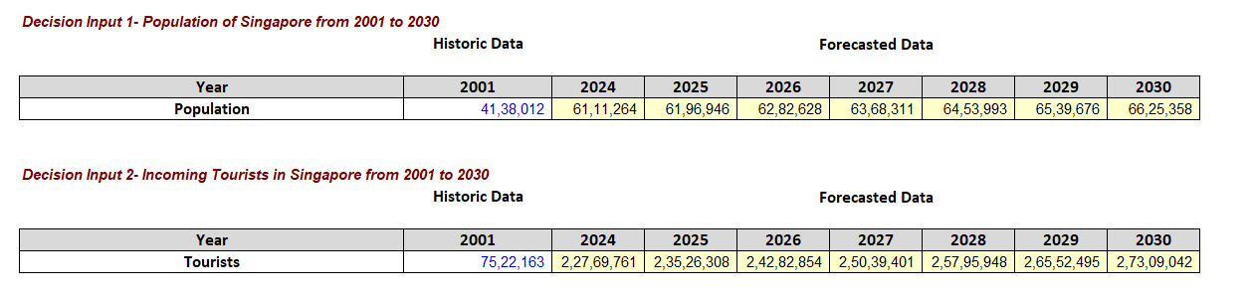
Time Series Forecast of Population and Tourists

Slide 8
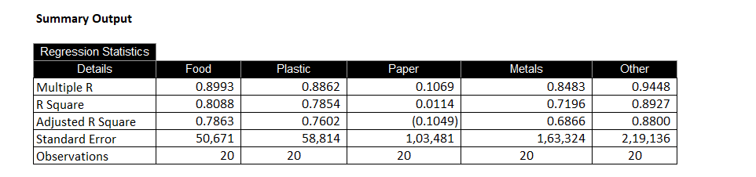
Linear Regression Models for Calculating Waste generated in different categories

Slide 9
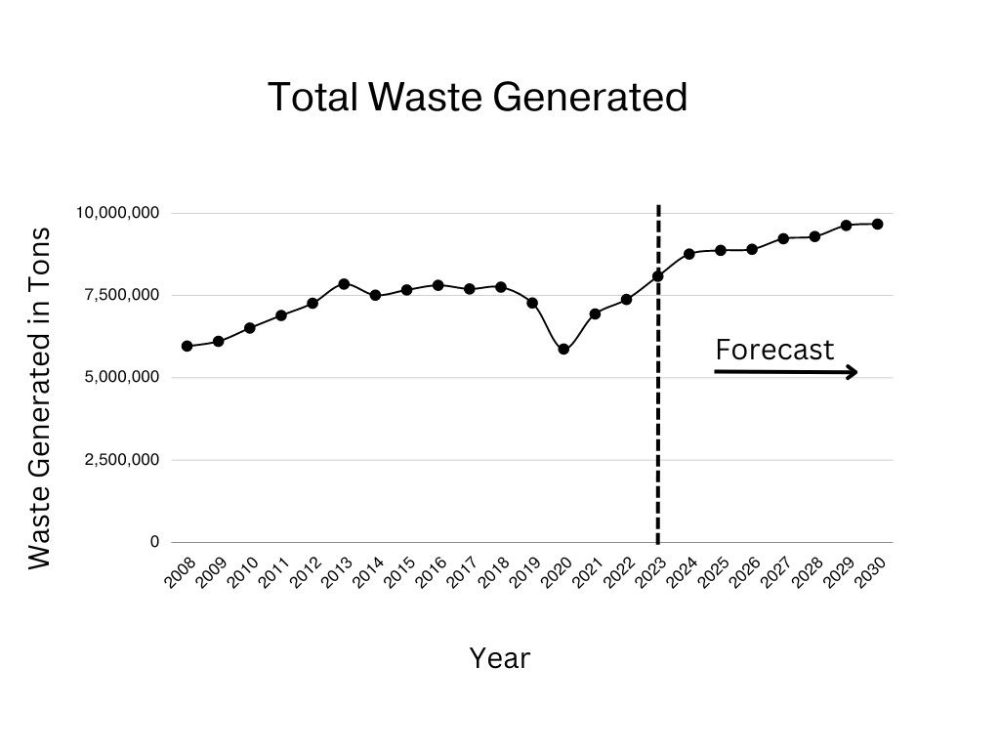
Projection of Waste Generated till 2030
Increase in population and incoming tourists till 2030
Time Series Forecast
Linear Regression Models
Paper Waste Generated to remain roughly constant
Increase in Food, Plastic, Metallic and Other Waste Generated

Slide 10
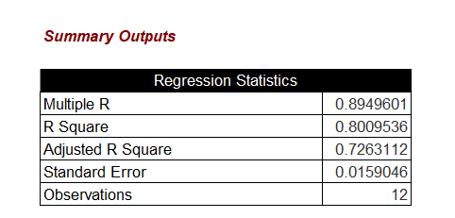
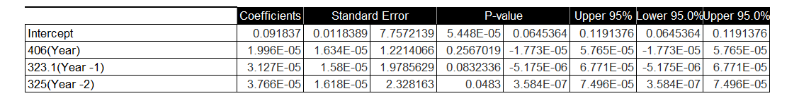
Projection of Food Recycling Rates: Linear Regression Model

Slide 11
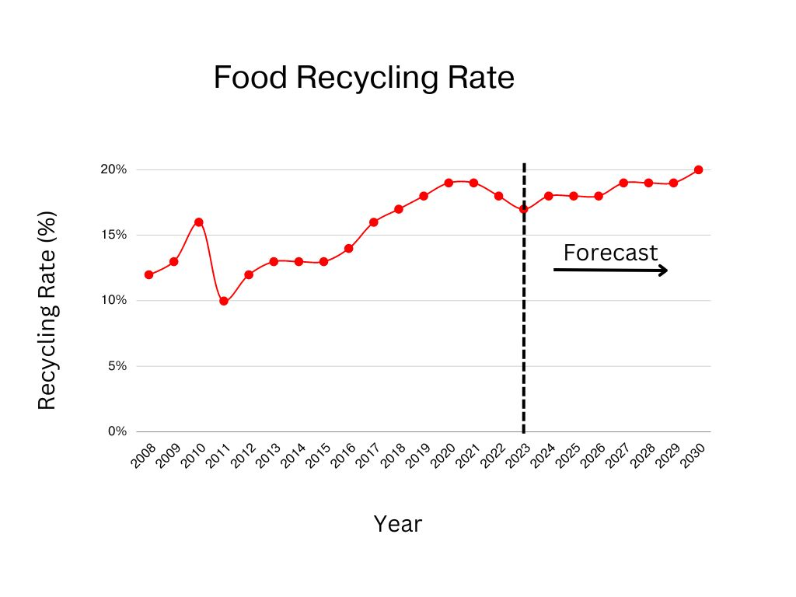
Projection of Food and Plastic Recycling Rates
Time Series Forecast
Expected Increase in NEA Development Expenditure
Linear Regression considering 3-year time window
Plastic Recycling Rates to remain constant or rangebound due to saturation in recycling infrastructure
Likely to lead to a slight improvement in Food Recycling Rates

Slide 12
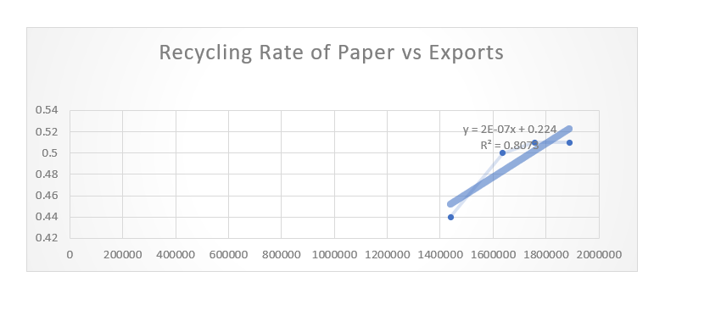
Recycling Rate of Paper with Recycling goods export market

Slide 13
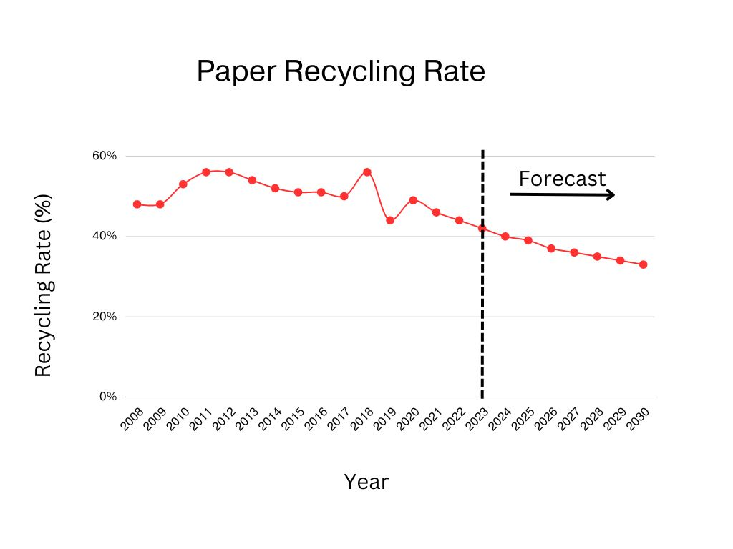
Projection of Paper Recycling Rates till 2030
Decrease in recycled goods export market due to growing digitalization, countries banning imports of recycled goods
Linear fit curve
Paper Recycling rates to decrease due to reduced demand of recycled paper

Slide 14
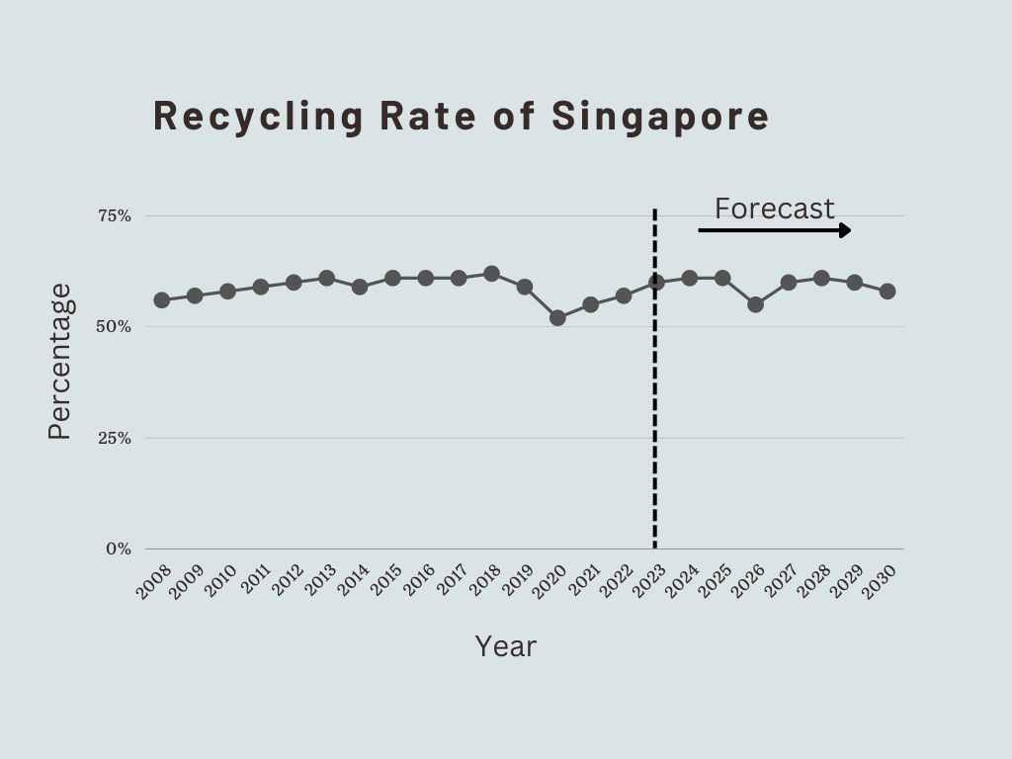
Overall Recycling Rate Projections through As-is Analysis

Slide 15

Understanding the As-is Analysis Results
Overall Recycling Rates from 2023 to 2030 are likely to remain in the same range as they were in the last few years between 57 and 61%.
Singapore needs to find new export markets in other countries for recycled goods to see an improvement in paper recycling rates.
Major breakthroughs in the form of technological advancements, and innovative strategies are needed to improve plastic recycling rates.
A significant technological advancement, policy decision, or innovative strategy is required to improve food recycling rates with lower investment.

Slide 16

Solver Analysis
Recycling rate of Plastic needs to improve significantly to around 50%
With existing food recycling infrastructure huge investment needed to improve food recycling rates.
A significant technological advancement, innovative strategy required to improve food recycling rates to 70% significantly with lower investment.
Recycling rates of paper need to hold constant or improve slightly.

Slide 17
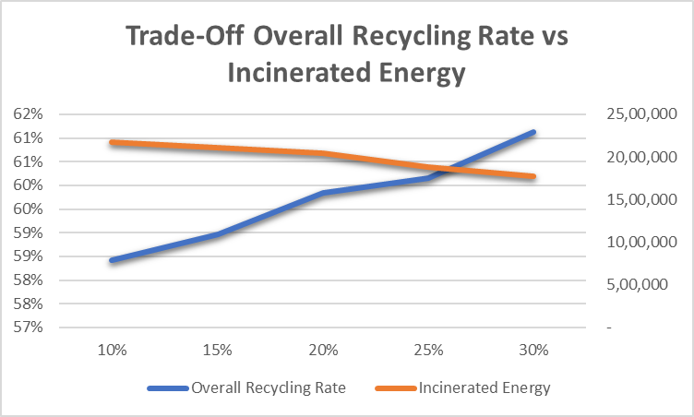
Trade-off Analysis: Overall recycling rate and Energy generated (Incineration) tradeoff with constant annual increase in NEA Development Expenditure
Increase in NEA Development Expenditure likely to improve food recycling rates which would in turn improve overall recycling rates.
This would lead to lower non-recyclable waste leading to lower energy generated through incineration plants.

Slide 18
Sensitivity Analysis: Finding new export markets for recycled goods at a constant rate starting 2023
This is likely to improve the recycling rate of paper and might lead to improvements in overall recycling rate.
This must be supplemented by increase in increase in plastic and food recycling rates to achieve the 70% target.

Slide 19
Sensitivity Analysis: Major technological breakthrough increasing plastic recycling rates significantly
Overall recycling rates will improve slightly from the As-is analysis projection. This won’t alone be sufficient to achieve the overall target of 70%
This increase needs to be supplemented by an increase in recycling rates in food and paper to achieve the overall target.

Slide 20

Demo

Slide 21
Thank You for Listening! Questions?

